Slide 1





Mathematicia
T.A. Invictus

Slide 2
MATHEMATICIA
TA INVICTUS
Group Members
1
2
3
4
Rohit Bhat
Harsh Niture
Chinmay Chougule
Meenal Garg

Slide 3





MATHEMATICIA
TA INVICTUS
Content
About
Uniqueness
Site Overview

Slide 4


MATHEMATICIA
TA INVICTUS
About Mathematicia
We, team INVICTUS present before you our own website - Mathematicia “Mathematics is not about numbers, equations, computations and algorithms; it is about understanding”
This understanding is what our team INVICTUS provides through MATHEMATICIA. Youth are the nation's future, and the 10th and 12th grades are among the most crucial years of a student's life since these grades present a major challenge i.e. Boards. To help students along their journey to a successful preparation with the right intake of knowledge is what Mathematicia is developed to achieve.

Slide 5


MATHEMATICIA
TA INVICTUS
Uniqueness
Our service section provides all the study materials required. Syllabus is given. You can refer to the topic wise notes. Access all formulas in one place for a quick revision. Reference books for extra help. Topic wise video links to clarify doubts. Quiz links to help you practice. Previous year questions to be more perfect And finally extras for extra help and much more.

Slide 6

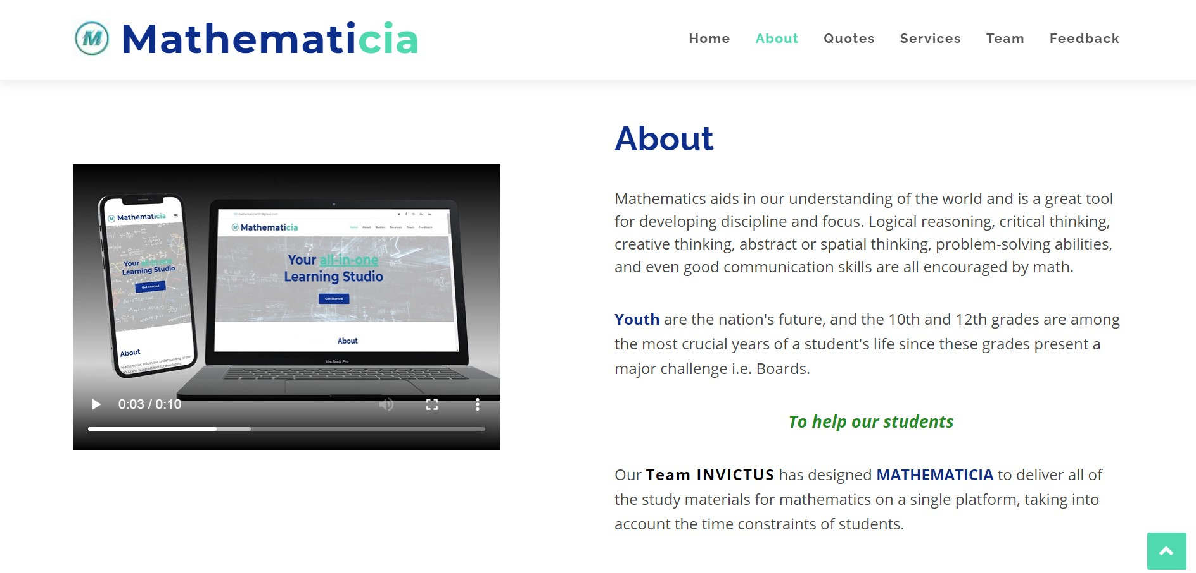

MATHEMATICIA
TA INVICTUS
Site Overview

Slide 7
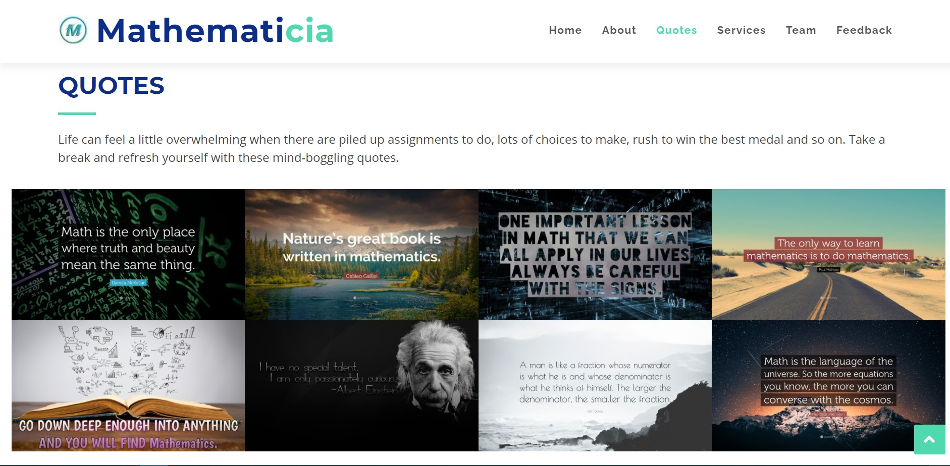
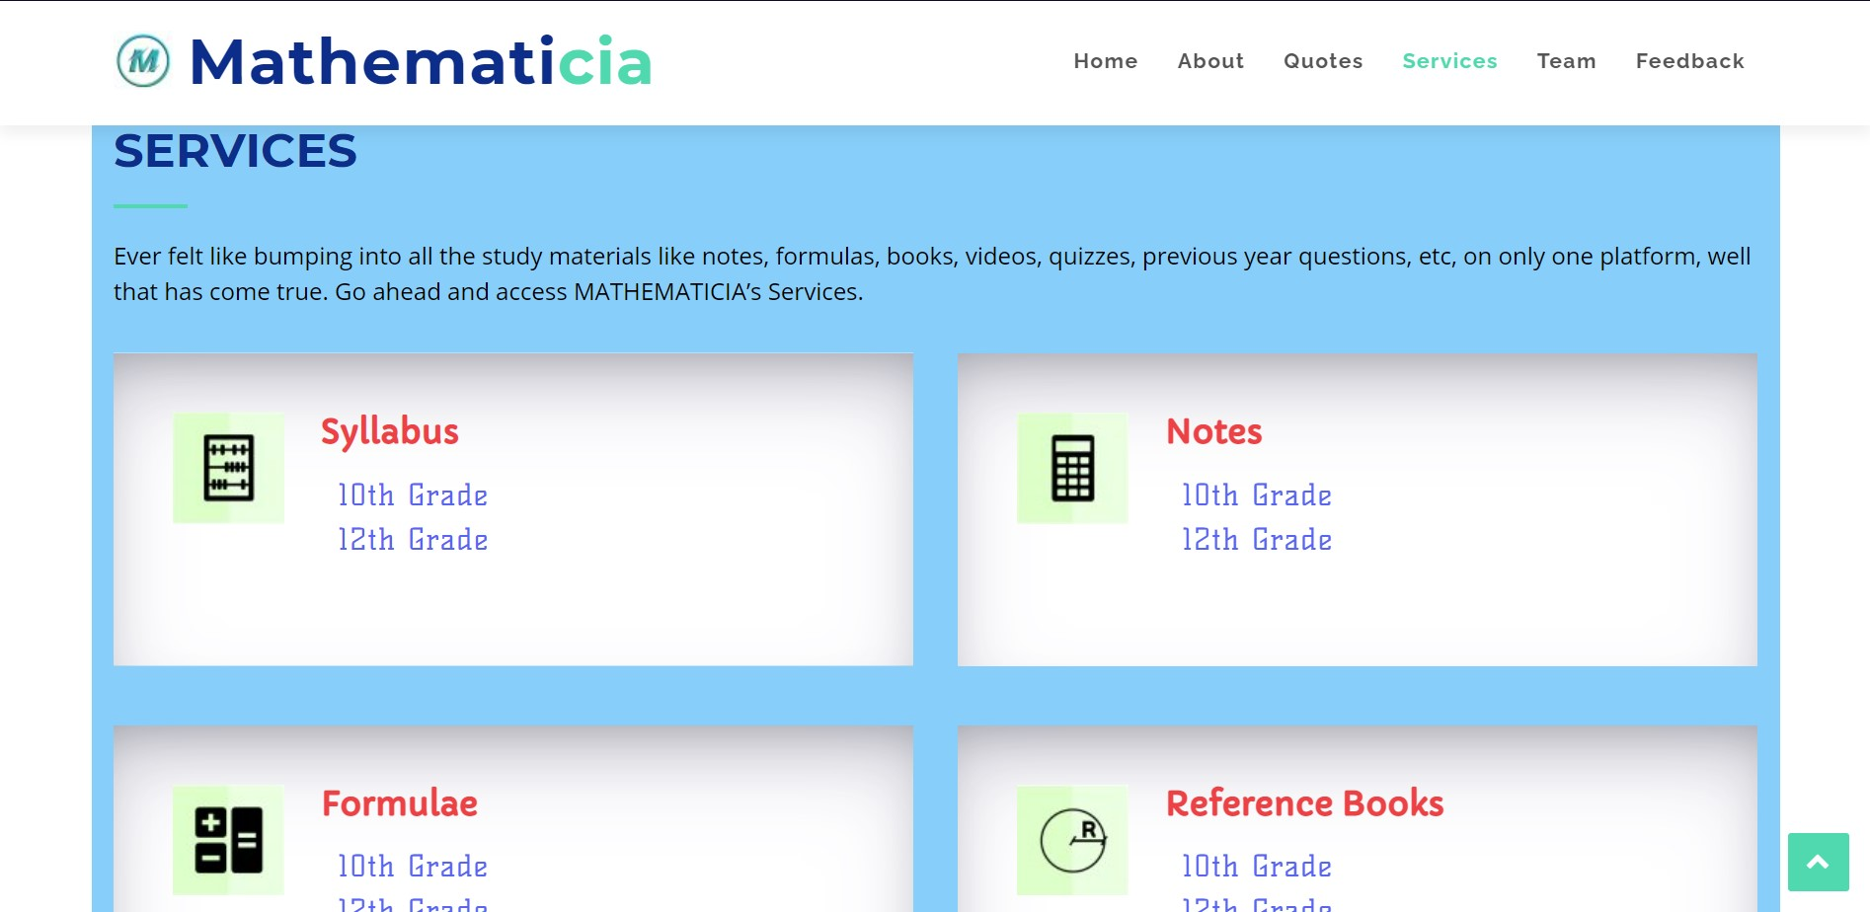

MATHEMATICIA
TA INVICTUS

Slide 8

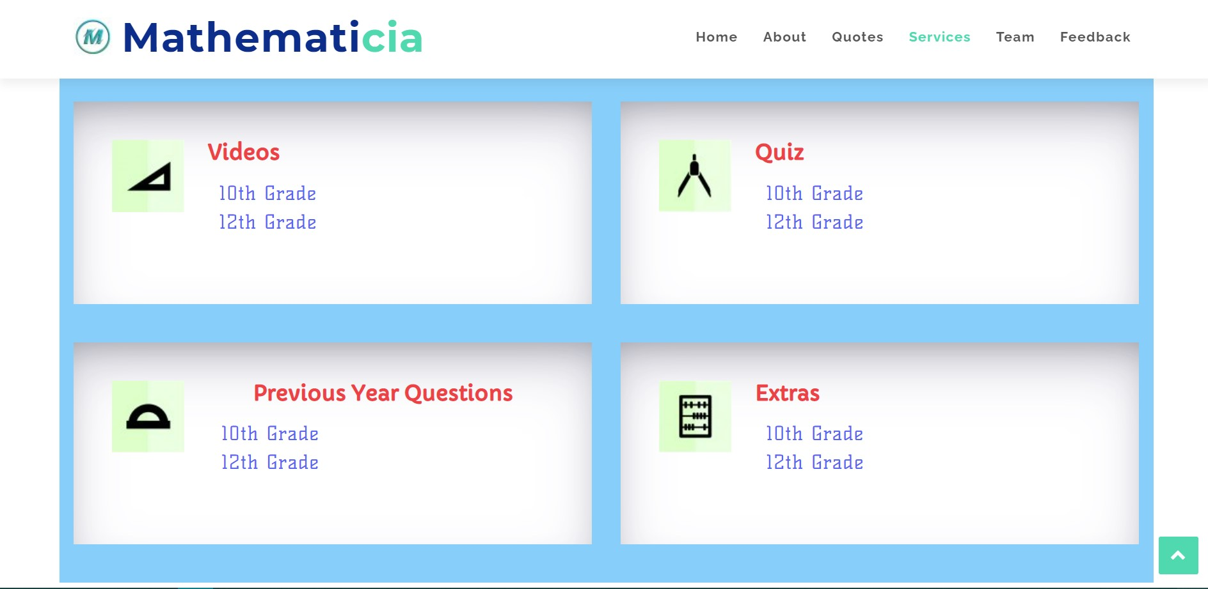
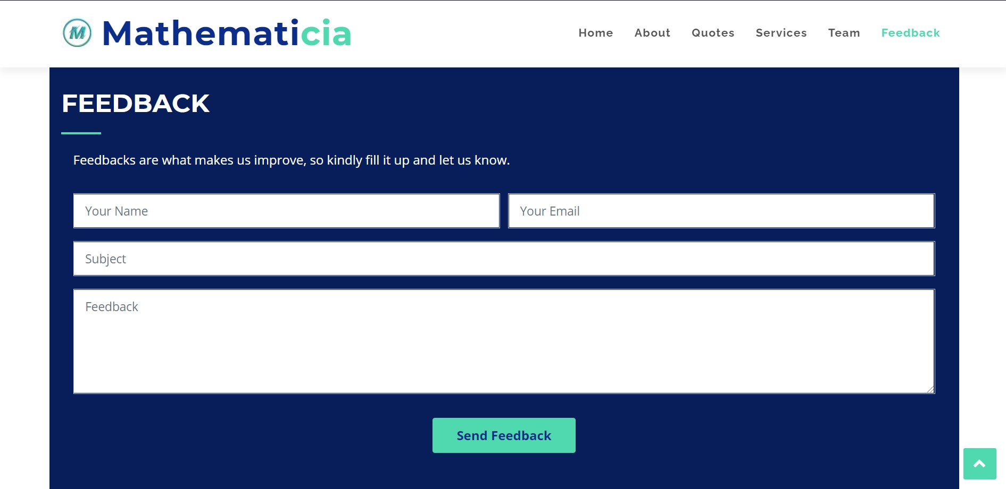

Slide 9
MATHEMATICIA
TA INVICTUS
And we're done for the day!
Thank You So Much !

